Slide 1
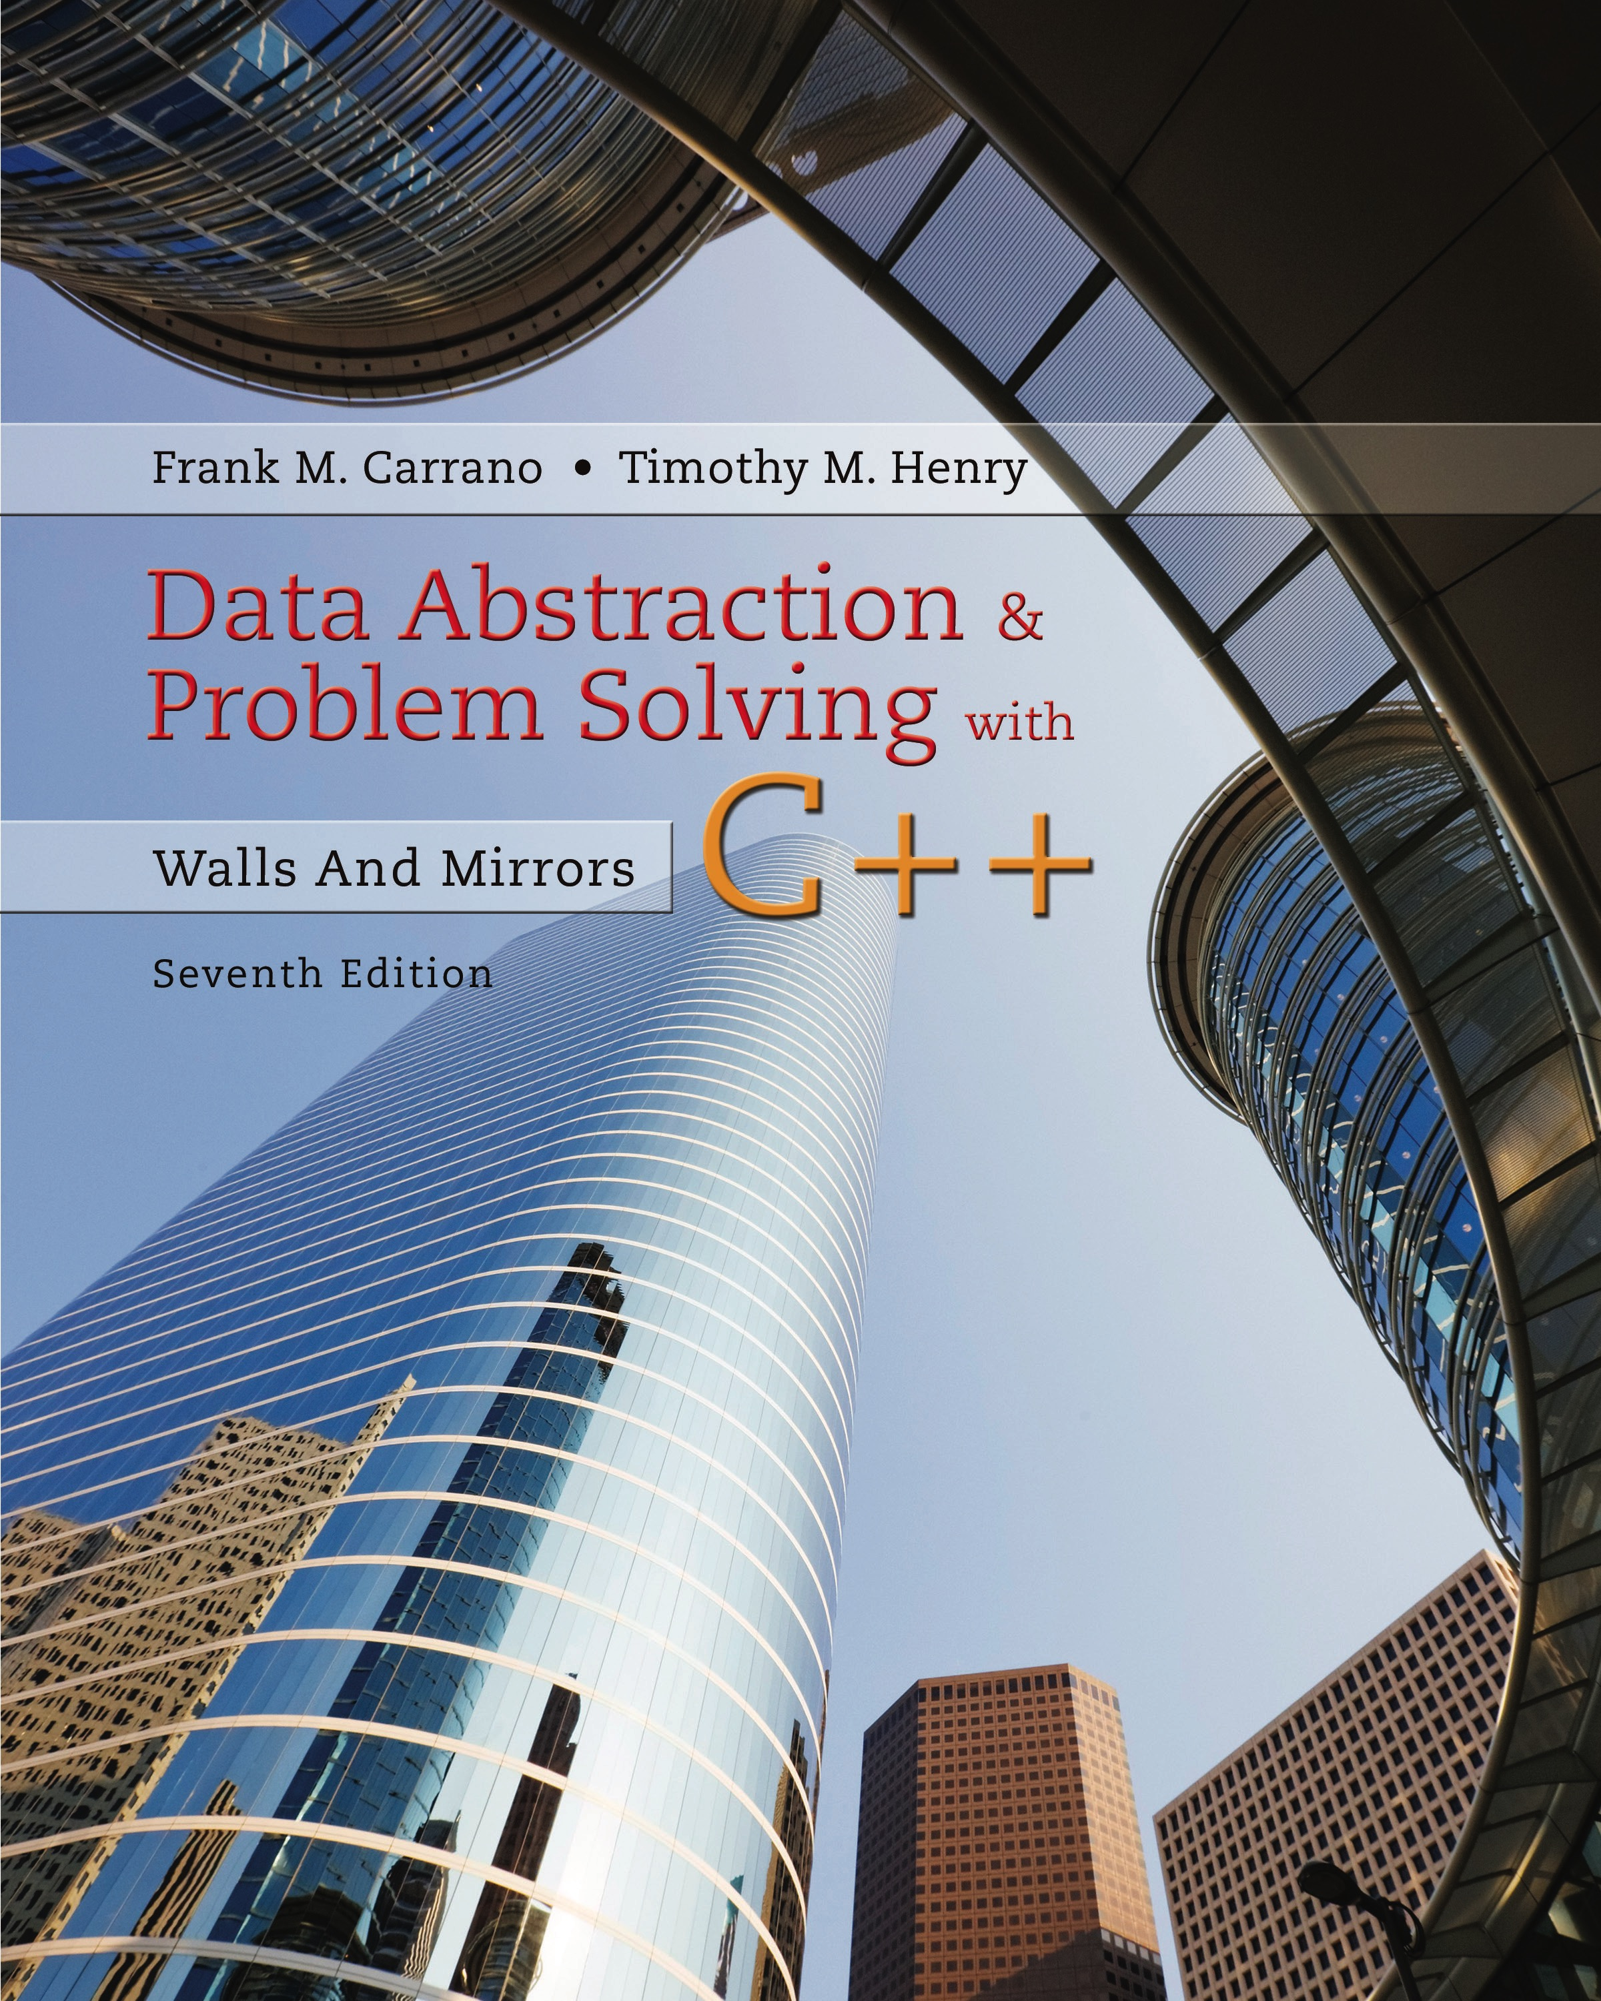
Data Abstraction & Problem Solving with C++: Walls and Mirrors
Seventh Edition
C++ Interlude 3
Exceptions
Copyright © 2017, 2013, 2007 Pearson Education, Inc. All Rights Reserved
Notes:
If this PowerPoint presentation contains mathematical equations, you may need to check that your computer has the following installed:
1) MathType Plugin
2) Math Player (free versions available)
3) NVDA Reader (free versions available)

Slide 2
Background
Preconditions for a method not always met
Method might return a false to indicate this
But not always possible
Example
Stack method peek() called on empty stack which contains items of type bool
Return cannot be sure if return is normal or an exception

Slide 3
Problem to Solve (1 of 3)
Previous C++ Interlude worked on video game
Next task
Create function that searches for given string in a number of boxes
Function parameters
Array of string objects
Integer represents number of objects in array
String to be located

Slide 4
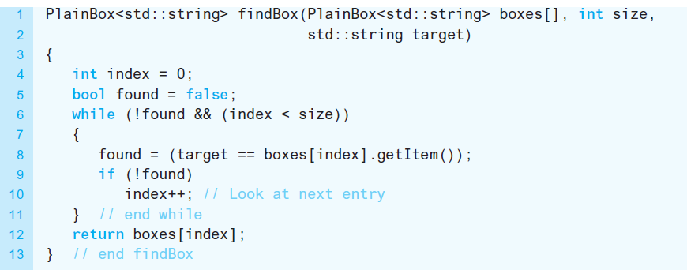
Problem to Solve (2 of 3)
Listing C3-1 First try at the function findBox

Slide 5
Problem to Solve (3 of 3)
Must deal with problem of a box containing target string not in the array
If target not found, function returns boxes[size] which is undefined
Problems occur when client tries to use this “box”
What to return when target not found?

Slide 6
Assertions (1 of 2)
Express an assertion either as a comment or by using the C++ function assert
Make assertions about variables, objects
Assertion in form of boolean expression that should be true at that point in program
False halts program execution
Mainly used to validate pre- or postconditions
This is a debugging tool
Not a substitute for an if statement

Slide 7
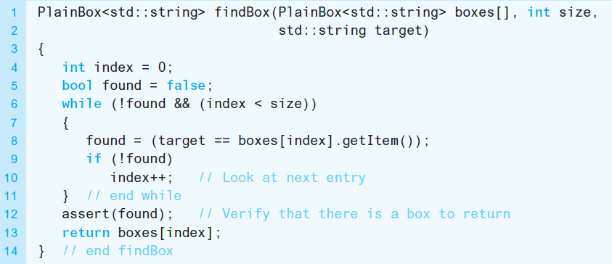
Assertions (2 of 2)
Listing C3-2 Revised findBox function with assertions

Slide 8

Throwing Exceptions (1 of 3)
Alternate way of communicating or returning information to function’s client
Thrown exception bypasses normal execution,
Control immediately returns to client.
Syntax

Slide 9
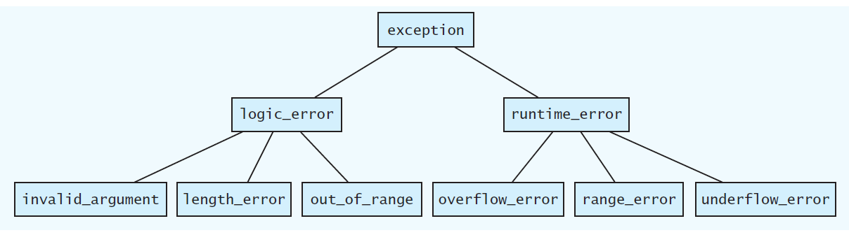
Throwing Exceptions (2 of 3)
Figure C3-1 Hierarchy of C++ exception classes

Slide 10
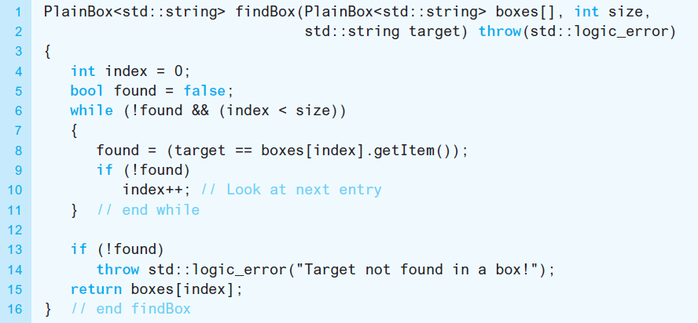
Throwing Exceptions (3 of 3)
Listing C3-3 Revised findBox function that throws an exception

Slide 11
Handling Exceptions (1 of 7)
Code for handling exception
try block–contains statements that might cause or throw an exception
catch block–immediately follows try block with code to react to or catch a particular type of exception

Slide 12
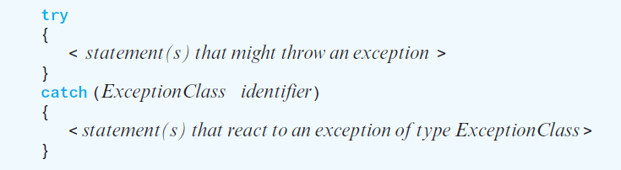
Handling Exceptions (2 of 7)
General syntax for a try block followed by one catch block

Slide 13
Handling Exceptions (3 of 7)
try block
Contains statements that might cause or throw an exception
catch block
One or more catch blocks immediately follow try block
Contain code to react to or catch particular type of exception

Slide 14
Handling Exceptions (4 of 7)
If no exception occurs and try block completes
Execution continues with statement after catch block
If statement within try block causes exception of type specified in catch block
Remainder of try block abandoned
Execution transfers to statements in catch block
After catch block statements finish, execution jumps to statement after last catch block

Slide 15
Handling Exceptions (5 of 7)
The syntax for catch block resembles that of a function definition
Specifies type of exception, and an identifier
The catch block parameter provides name for caught exception
Steps taken in catch block vary
Simple message
Elaborate update of variables, retry of offending function

Slide 16
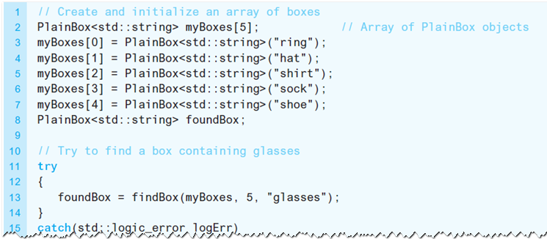
Handling Exceptions (6 of 7)
Listing C3-4 Trying the function findBox

Slide 17
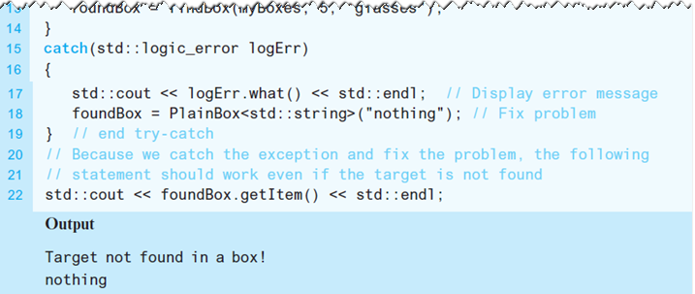
Handling Exceptions (7 of 7)
Listing C3-4 [Continued]

Slide 18
Multiple Catch Blocks
try block may cause more than one type of exception
Can have many catch blocks associated with it
catch blocks must be ordered
Most specific classes first
More general classes last

Slide 19
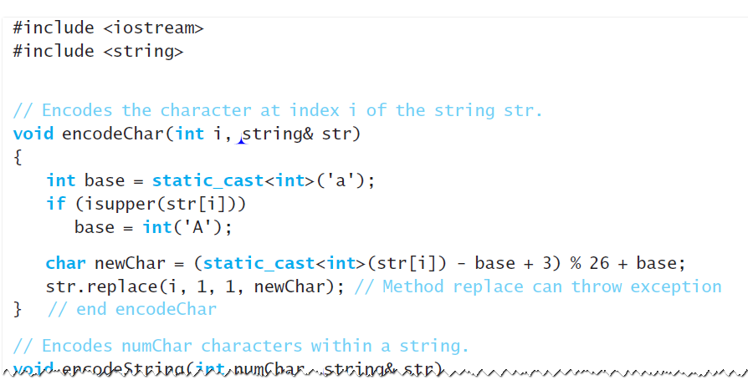
Uncaught Exceptions (1 of 4)
Listing C3-5 A program with an uncaught exception

Slide 20
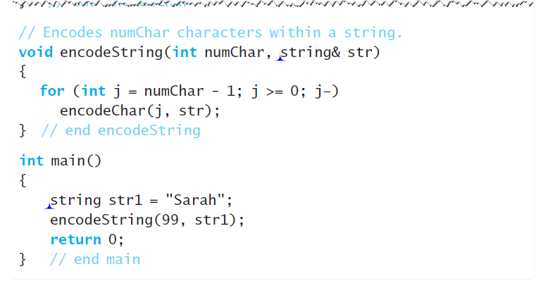
Uncaught Exceptions (2 of 4)
Listing C3-5 [Continued]

Slide 21
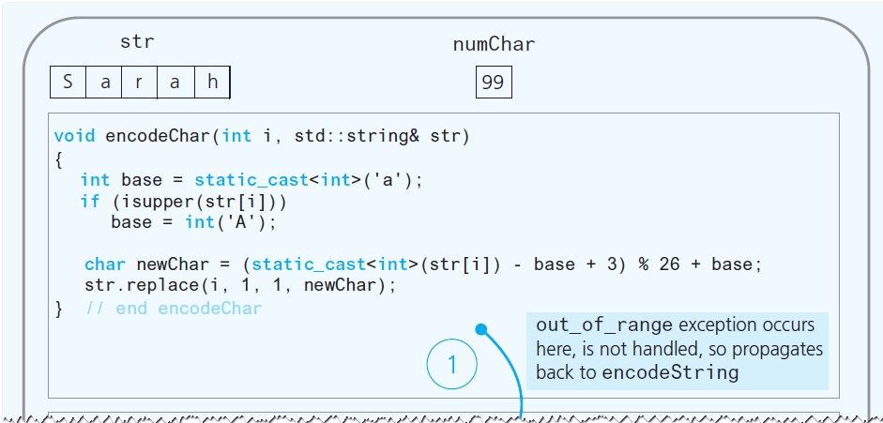
Uncaught Exceptions (3 of 4)
Figure C3-2 Flow of control for an uncaught exception

Slide 22
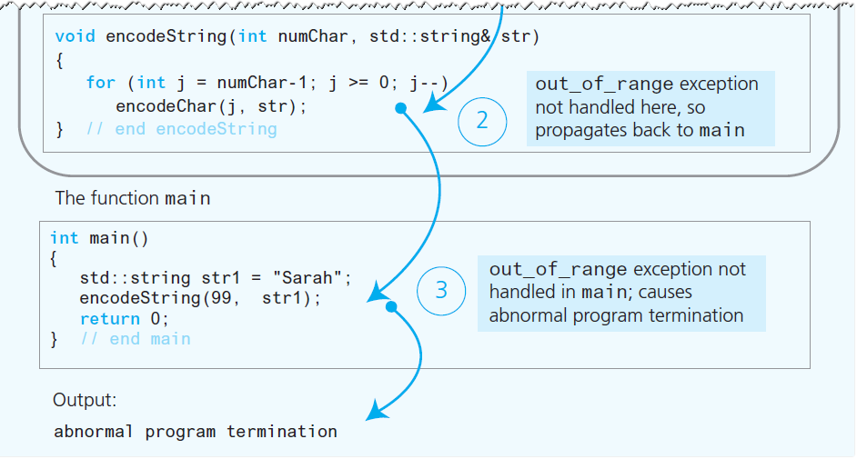
Uncaught Exceptions (4 of 4)
Figure C3-2 [Continued]

Slide 23
Programmer-Defined Exception Classes (1 of 2)
Usually, C++ exception class exception , or one of its derived classes, is the base class
Provides a standardized interface for working with exceptions.
Exception class typically consists of a constructor that has a string parameter

Slide 24
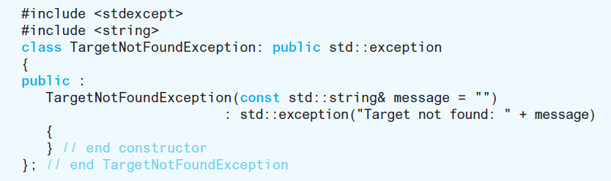
Programmer-Defined Exception Classes (2 of 2)
Example–constructor provides way for throw statement to identify condition of exception.

Slide 25

Copyright

